Slide 1


Nucleon correlations in
Nuclear Lattice Effective Field Theory
Young-Ho Song (IRIS, IBS)
2025.11.17. NuSRAP2025, Seoul, Korea

Slide 2

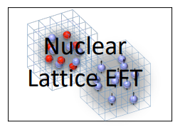
NLEFT collaboration
Nuclear Lattice Effective Field Theory ( NLEFT )
International Collaboration
(USA, Germany, China, Turkiye, Korea etc.)
This work:
Young-Ho Song
Myungkuk Kim, Youngman Kim
Kihyeon Cho
Serdar Elhatisari
Dean Lee, Yuan-Zhuo Ma
Ulf-G. Meißner

Slide 3
OUTLINE
Nuclear Lattice Effective Field Theory ( NLEFT )
Basic idea
Wave function matching method
Applications
Nucleon Correlations in Carbon/Oxygen isotopes
Summary

Slide 4
Nuclear Lattice Effective Field Theory
Advances of ab initio nuclear theory
Many approaches for nuclear few-, many-body systems
Based on NN (and NNN) interaction
Even applicable for A~ 100 nuclei in some approach
No-core shell model
Diffusion or Green’s function Monte Carlo
Many-body perturbation theory
In-medium similarity renormalization group
Coupled cluster
Etc.
Nuclear Lattice Effective Field Theory:
Complementary information which may be difficult in other methods.

Slide 5
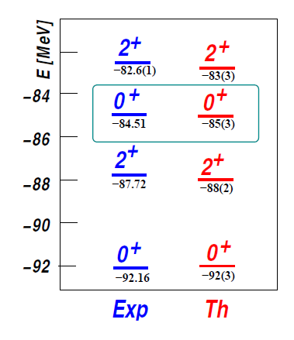
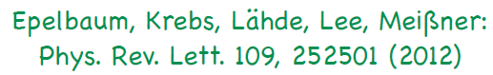
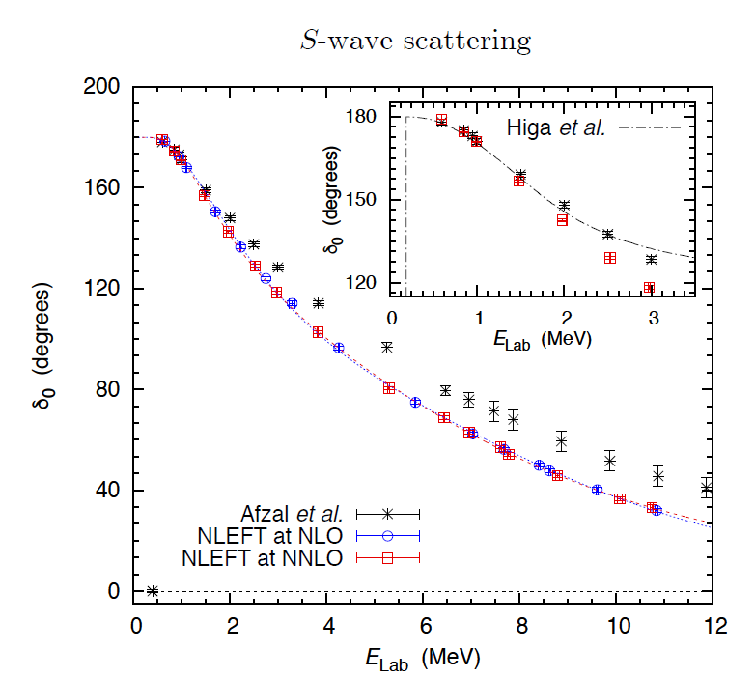
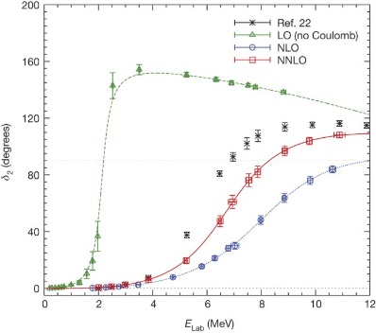
Nuclear Lattice Effective Field Theory
The first ab-initio calculation of
Hoyle state
Has been successfully applied to
Nuclear matter, Cold atom, dilute fermion system
Finite nuclei (A<=50)
First ab-initio calculation of Hoyle state
Cluster structure of ¹²C and ¹⁶O
NN scattering, N-D scattering
Alpha-alpha scattering
radiative capture, fusion
Etc.
Ab initio alpha-alpha scattering
( Nature 528, 111-114(2015))

Slide 6
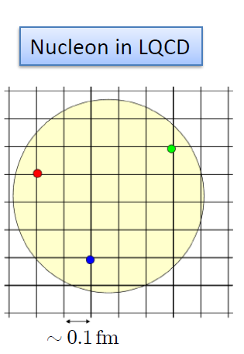
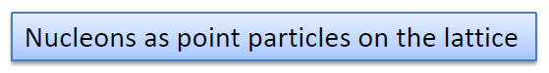
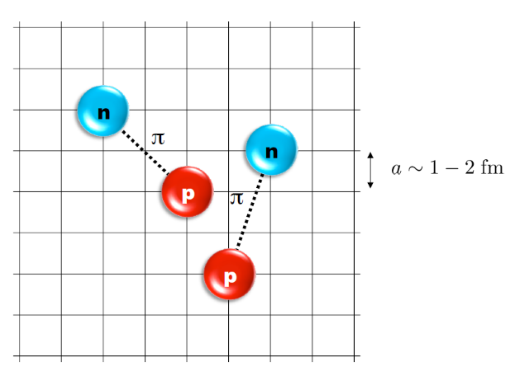
Nuclear Lattice Effective Field Theory
NLEFT = Lattice + Monte Carlo+ Chiral EFT
Lattice
Lattice spacing : a ~ 1 fm
Lattice size : L ~ 10 a
Cutoff of the theory
Monte Carlo
Expectation value
by Auxiliary field MC
Polynomial scaling
Chiral EFT
2N interaction
3N interaction

Slide 7
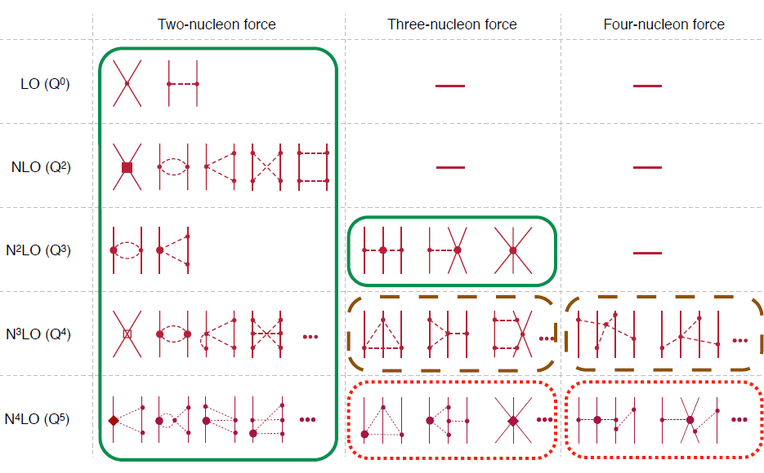
Chiral Effective Field Theory
Organized
According to their
Expected
importance
at low energy
Dominant interaction(LO ) must be
treated
non-perturbatively
Corrections (Higher orders) can be treated
perturbatively.

Slide 8
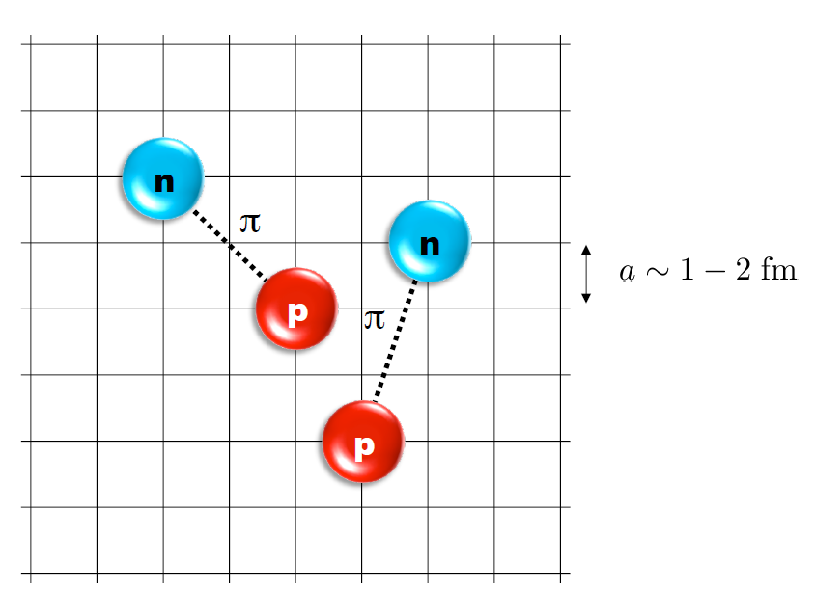
Lattice Hamiltonian
However, one cannot simply
adopt the chiral interaction
in continuum into lattice.
(need modification)
momentum space cutoff ~ 150 MeV → lattice spacing a= 1.316 fm
Time cutoff ~ 1000 MeV
We need to determine coefficients of interaction for the lattice size. (regularization scale.)
Two-body interaction coefficients can be determined from phase shifts of np scattering.
Three-body interaction can be fixed from binding energy of A>=3.

Slide 9
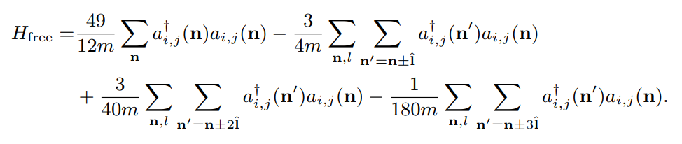
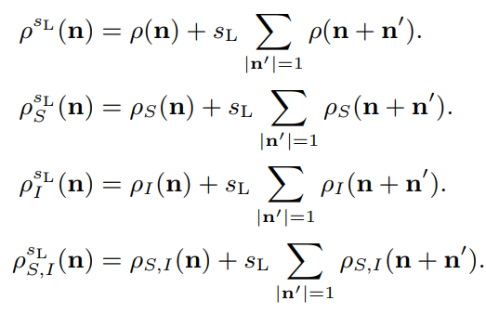
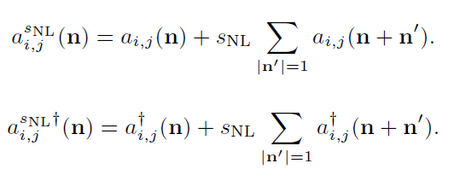
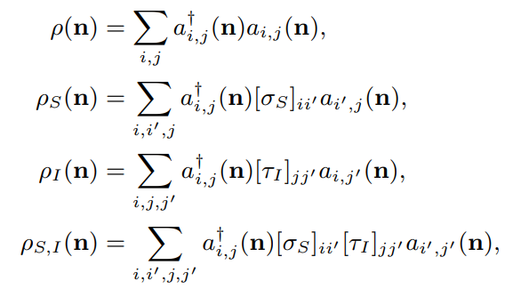
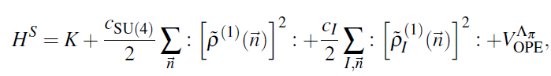
Lattice Hamiltonian
Kinetic Energy
Local density operators
Local smeared density operators
Non-local smearing

Slide 10
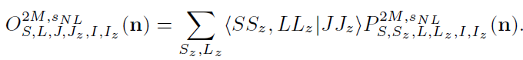
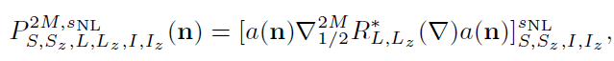
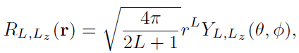
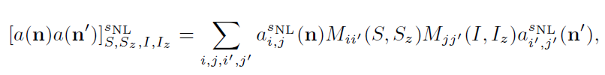
Lattice Hamiltonian
Partial wave projected Pair annihilation operator
Interactions in each partial wave can be constructed
by using these pair creation/annihilation operators

Slide 11
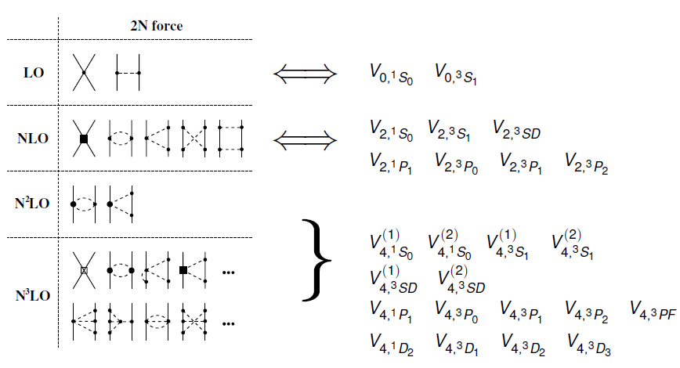
Lattice Hamiltonian

Slide 12
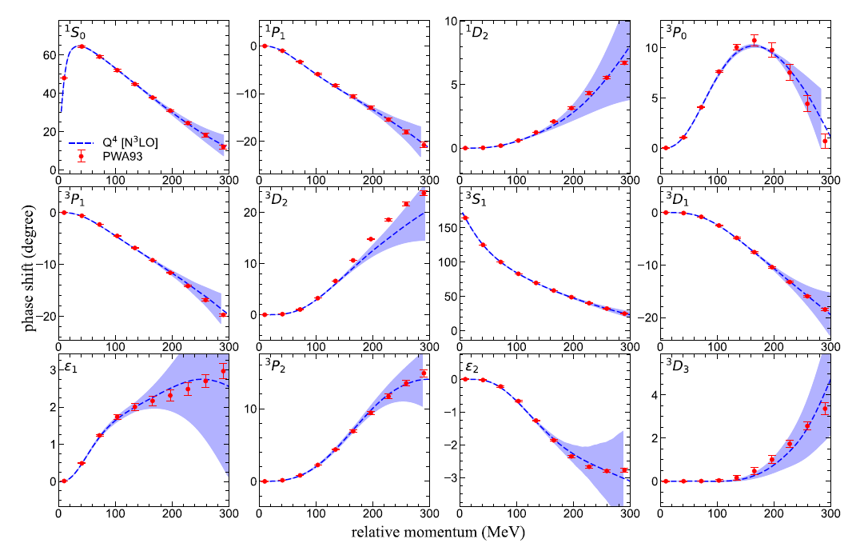
Lattice Hamiltonian
Determine
Higher order NN interaction
From the
phase shifts of NN scattering.

Slide 13
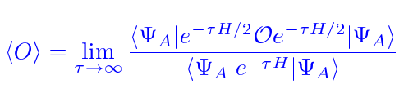
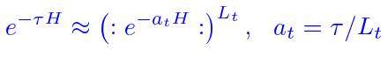
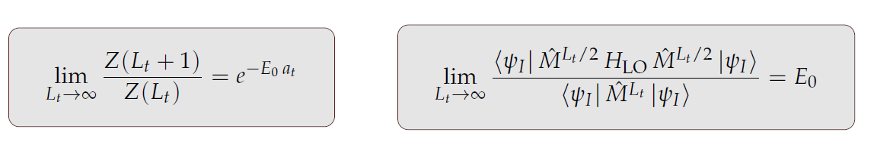
Auxiliary Field Monte Carlo
Expectation value of an observable by projecting WF at large Euclidean time
Discretization in Euclidean time evolution by transfer matrix

Slide 14
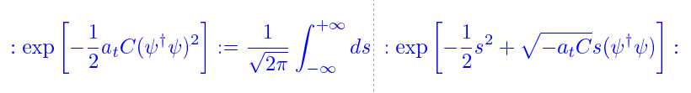
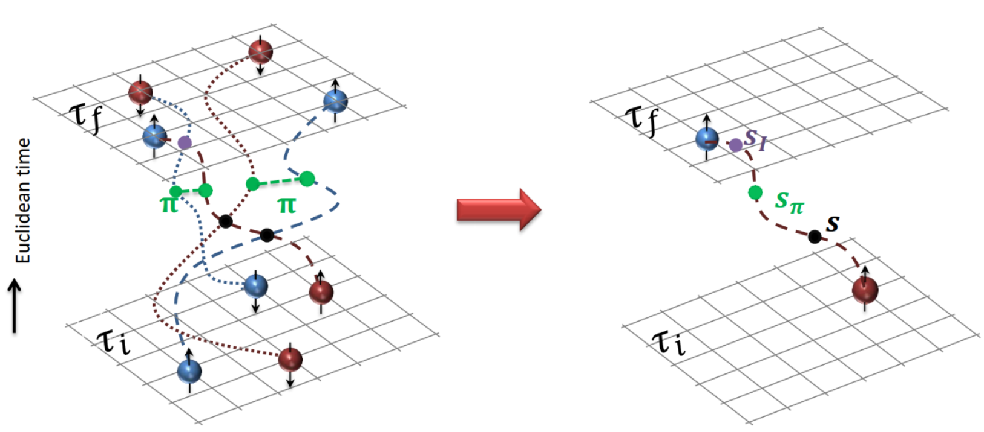
Auxiliary Field Monte Carlo
Transform transfer matrix via Gaussian integral of auxiliary fields
Interacting nucleons
Nucleons interacts with auxiliary fields
(no direct interaction
between nucleons)
computing fermion
Correlator amplitude
Integration
over auxiliary fields
M.C. integral
(sampling auxiliary field)

Slide 15
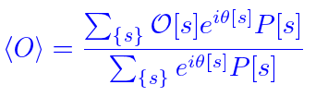
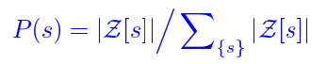
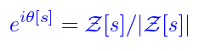
Auxiliary Field Monte Carlo
Auxiliary field integration → M.C. Sum of Auxiliary Fields Samplings
Probability and Phase factor
Sign oscillation from complex phase factor
→ Major limitation in practical AFMC calculation.

Slide 16
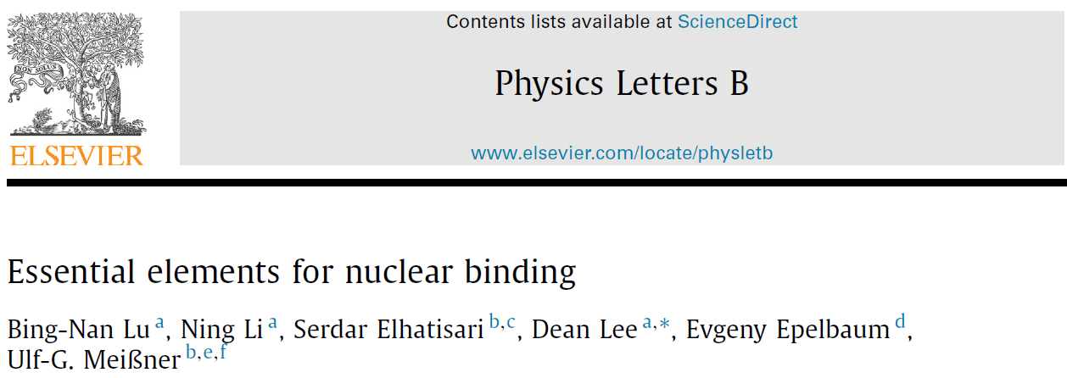
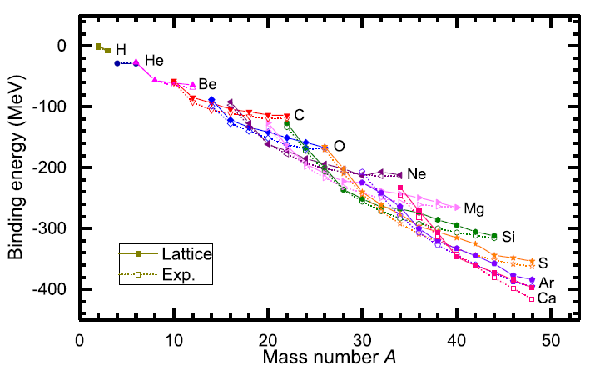
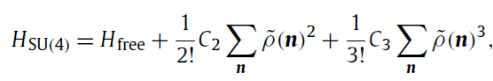
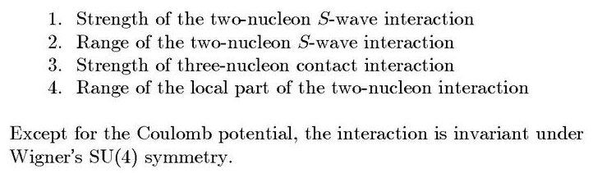
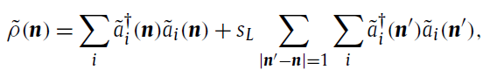
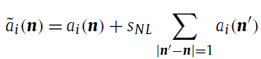
SU(4) symmetric Hamiltonian
Minimal nuclear interaction
Which reproduce
Light nuclei
medium mass nuclei
neutron matter
simultaneously up to few percent error in binding energy and charge radius
Only Four parameters
No sign problem

Slide 17
Lattice Hamiltonian
Full N3LO Hamiltonian includes
Free Hamiltonian(Kinetic term)
Short range (nonlocal smeared) contact interactions up to Q^4 order
Isospin-breaking short range interactions
One pion exchange potential
Two pion exchange potential up to Q^4 order
Coulomb interaction
Long range isospin breaking interaction( isospin dependence in OPE)
Galilean Invariance Restoration (GIR) term (because of non-local interaction.)
Three nucleon interaction
Severe Sign problem in heavier nuclei
need to reduce the sign problem
Wigner SU(4) symmetric interaction → no sign problem.
One may find a simple Hamiltonian in decent agreement with experiments.

Slide 18
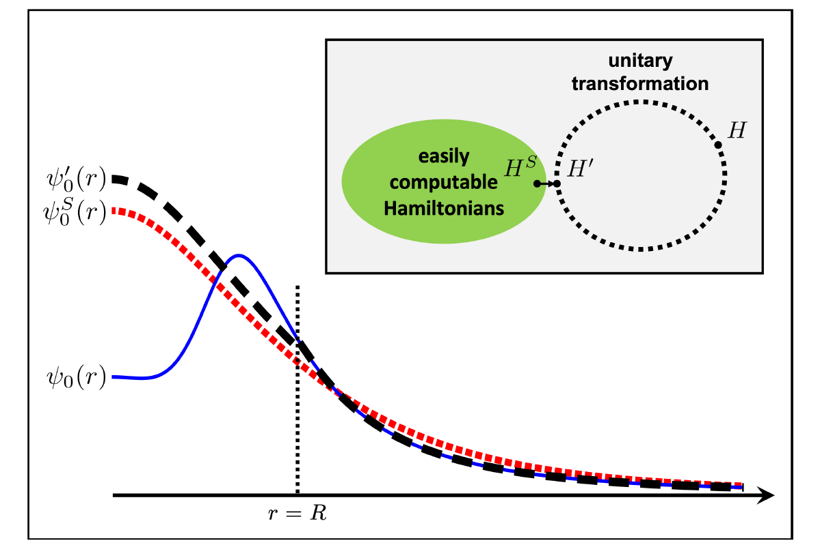
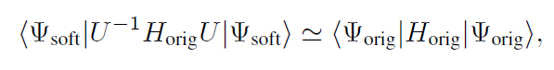
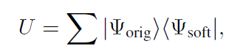
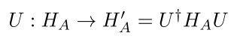
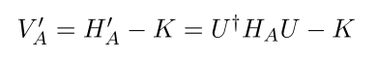
Wave function matching
H and H’ are fully equivalent to two-body observables
The goal is to make the perturbation expansion from “simple” wave function gives a good convergence
U is only active
At r < R
Two potentials V_A and V’_A are unitarily equivalent.
Same phase shifts.
H’_A has eigenvectors of H_B, but eigenvalues of H_A

Slide 19
Wave function matching
“Simple” Hamiltonian :
“Full” Hamiltonian: Chiral EFT upto N3LO
U is only active
At r < R
Two potentials V_A and V’_A are unitarily equivalent.
Same phase shifts.
H’_A has eigenvectors of H_B, but eigenvalues of H_A

Slide 20
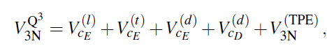
Wave function matching Hamiltonian
N3LO Hamiltonian
V_2N : short range NN interactions
W_2N: GIR restoration term for V_2N
V_2N,WFM : difference from H’-H
W_2N,WFM: GIR restoration correction to V_2N,WFM
V_3N : contains short range 3N interaction parameters(to be fitted)
and two pion exchange correction to 3N

Slide 21
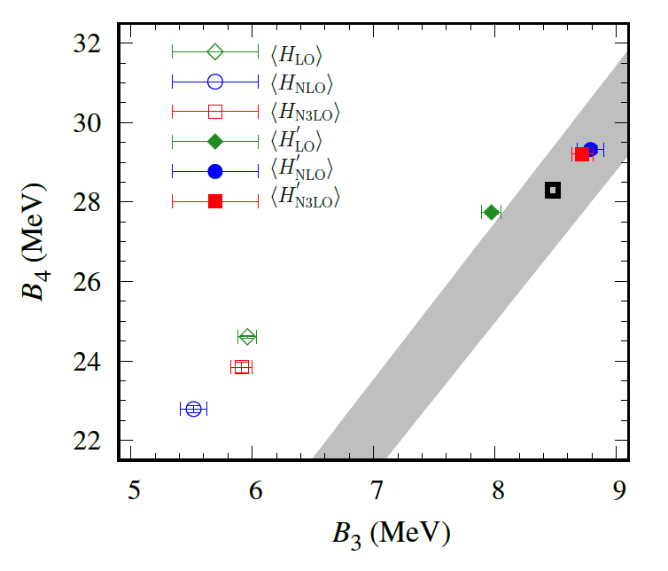
Wave function matching Hamiltonian
Realistic two-body interaction
Correlation between 3-body and 4-body binding energy
Tjon Line
WFM approach gives binding energy lies on the Tjon line.
→ Accurate reproduction of B.E. requires 3-body force.

Slide 22
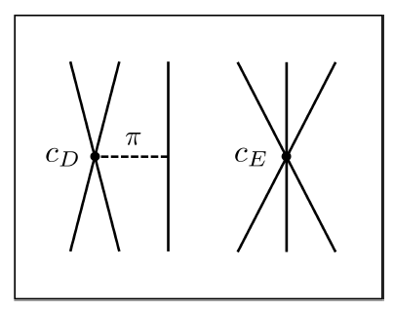
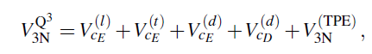
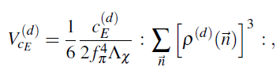
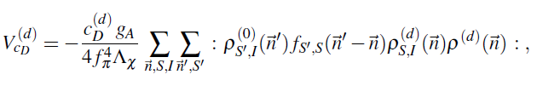
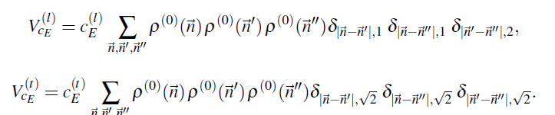
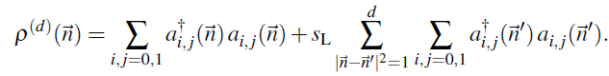
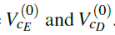
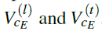


Wave function matching Hamiltonian
Three-body Force
NNLO
At N3LO:
TPE and
Adjustments to
cD and cE terms.

Slide 23

BE/A from WFM
RMSD ~ 0.1 MeV per nucleon

Slide 24

Charge Radius
No fitting! RMSD~ 0.03 fm

Slide 25

Nuclear/Neutron Matter
Neutron matter:
A=4~80
box size 6.6 ~ 13.2 fm.
Nuclear matter:
A=4 ~ 160
Box size 7.92~9.24 fm.
Uncertainties from
finite system size correction

Slide 26

Carbon and Oxygen
WFM method
Carbon and Oxygen isotopes

Slide 27


Carbon and Oxygen

Slide 28
Carbon isotopes (Lt=200)

Slide 29

Oxygen isotopes (Lt=200)

Slide 30
Partial wave contributions
Operator expectation values
Not a physical observable
Phase shift
(quasi) physical observable
Sensitivity of a quantity on
phase shift change
Model independent framework
(in the sense that one can compare
two EFTs regardless of their details)
1% phase shift change at p=150 MeV
(~ cutoff scale in NLEFT )

Slide 31

1S0 contributions
1% Phase shift reduction
At p=150 MeV in 1S0
Change in two-body energy
Z= 6
<pp1S0> : near constant
<nn1S0> : strong correlation among paired neutrons
Carbon isotopes

Slide 32





Tz linearlity
A(1,Tz) is a two nucleon annihilation operator
which gives isospin change by (1, Tz)
f(-1) : two proton operators ( two-body interaction) expectation value
f(0) : proton-neutron operators
f( 1) : two neutron operators

Slide 33

Tz linearlity
If each of extra neutrons are uncorrelated with each other
Independent particles (= core +valences)
(2) zero contribution among valence neutron pairs
→ Contributions of each extra neutrons to f will be additive.
In general, this will be non-zero because extra neutrons are correlated.
Difference between left and right is
a measure of correlation between additional neutrons.
We chose operator A having the same form of LO interaction

Slide 34

1S0 contributions
Oxygen isotope 1S0 correlations
PP does not change much over isotopes
→ pp correlations within alpha clusters remain mostly intact as extra neutrons added
→ Carbon and Oxygen are dominated by alpha cluster like structure.
There is a pairing like pattern in nn-correlations
→ adding unpaired odd neutron slopes are very close to 2pn-pp
→ unpaired neutron is only weakly correlated with the other extra neutrons and predominantly interacting with T=0 nuclear core.
Similar observation was done in Shell model calculation.

Slide 35
1S0 contributions
Carbon isotopes
Oxygen isotopes
Carbon and Oxygen isotopes: additional odd neutron shows similar slope for <nn> and <2pn-pp>

Slide 36

1S0 contributions
Oxygen isotopes
Carbon isotopes
Similar results with reference momentum p=100 MeV.
(1% Phase shift reduction at p=100 MeV)

Slide 37


3P0 contributions
Carbon isotopes
Oxygen isotopes
3P0 is less sensitive to the phase shift change than 1S0
17O,13C shows good Tz linearity.
Rapid slope change at N=14 (closure of 1d5/2 subshell at N=14)

Slide 38
Summary
Wave function matching method seems to be promising
Carbon, Oxygen isotope up to dripline shows good agreement with experimental data
Analysis of partial wave contribution enables to study
(mean-field) level structures of nuclei in NLEFT.
Additional neutrons in 1S0 have strong pairing correlation
Unpaired neutrons correlated primarily to the nuclear core.

Slide 39

Thank You

Slide 40


3P1 (T=1)

Slide 41


3P2 (T=1)

Slide 42


1D2 (T=1)

Slide 43


3S1 (T=0)

Slide 44


1P1 (T=0)

Slide 45


3D1 (T=0)

Slide 46


3D2 (T=0)

Slide 47


3D3 (T=0)

